Slide 1
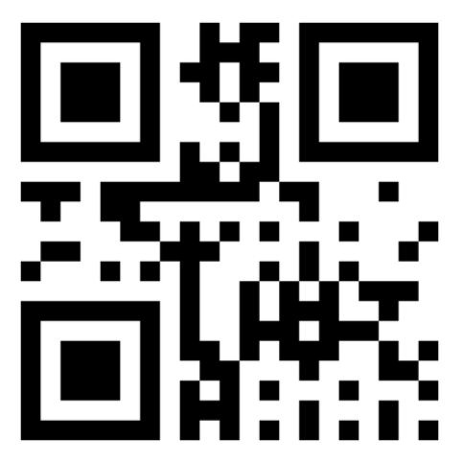
Please register your attendance by scanning the QR code below
GEOG0186/GEOG0188
Registration needs to be logged
by 09:20am
Code: 129410
Room 422/423 Malet Street (Birkbeck)
Group A: 09:00 to 10:00am

Slide 2
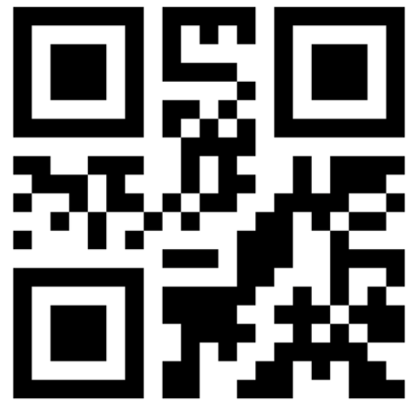
Please register your attendance by scanning the QR code below
GEOG0186/GEOG0188
Registration needs to be logged
by 10:20am
Code: 218317
Room 422/423 Malet Street (Birkbeck)
Group B: 10:00 to 11:00am

Slide 3
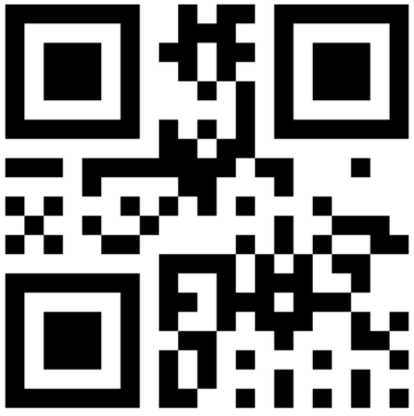
Please register your attendance by scanning the QR code below
GEOG0186/GEOG0188
Registration needs to be logged
by 11:20am
Code: 329426
Room 422/423 Malet Street (Birkbeck)
Group C: 11:00am to 12:00pm

Slide 4
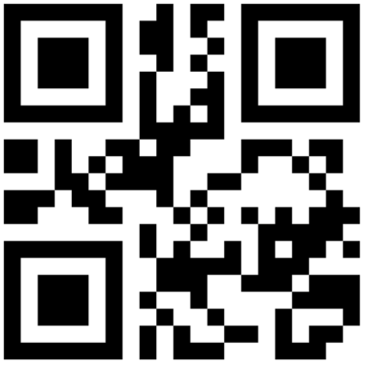
Please register your attendance by scanning the QR code below
GEOG0188
Registration needs to be logged
by 11:20am
Code: 364002
2.23 Chadwick Building (UCL)
Group D: 11:00am to 12:00pm

